Slide 1
Higher Order Derivatives, Velocity and Acceleration

Slide 2
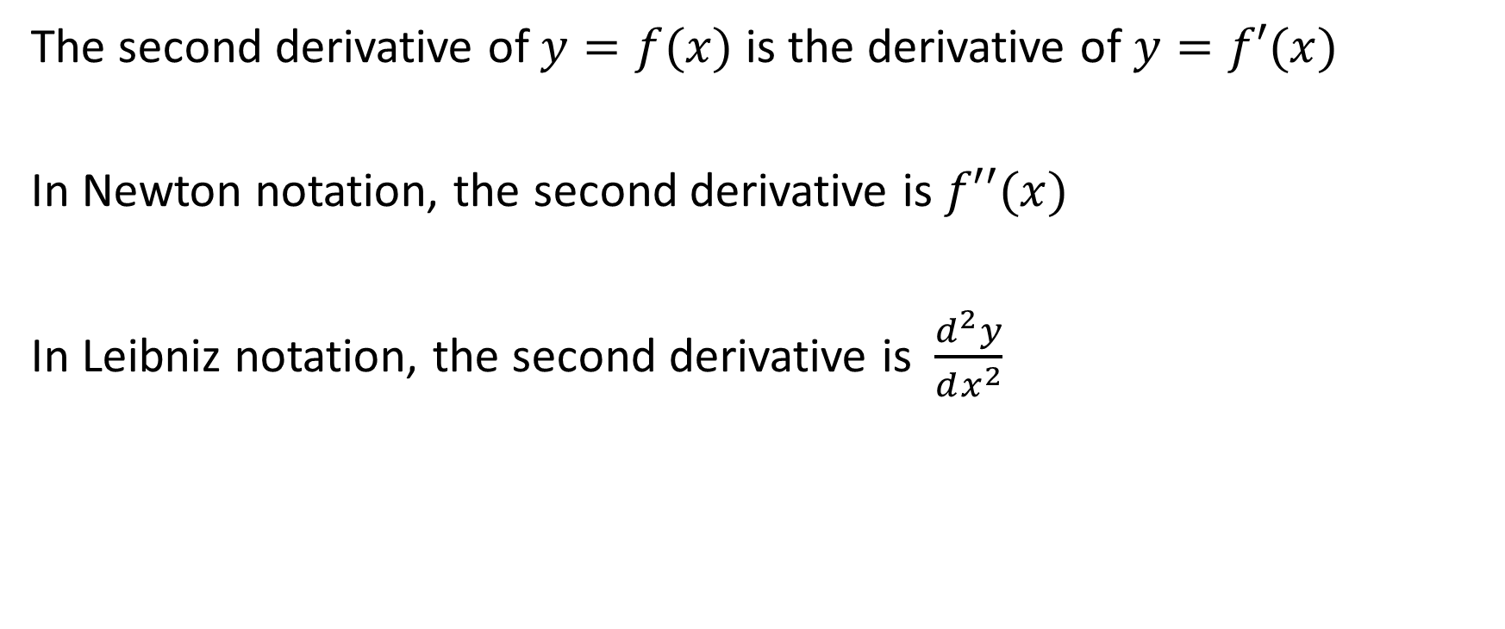
The second derivative of $y=f(x)$ is the derivative of $y=f′(x)$
In Newton notation, the second derivative is $f′′(x)$
In Leibniz notation, the second derivative is $\frac{d^{2}y}{dx^{2}}$

Slide 3
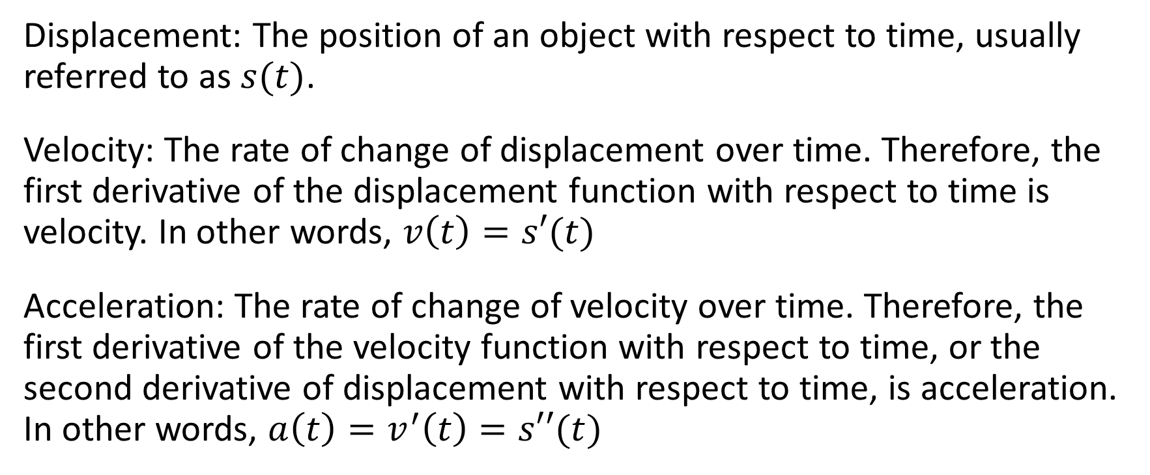
Displacement: The position of an object with respect to time, usually referred to as $s(t)$.
Velocity: The rate of change of displacement over time. Therefore, the first derivative of the displacement function with respect to time is velocity. In other words, $v\left(t\right)=s′(t)$
Acceleration: The rate of change of velocity over time. Therefore, the first derivative of the velocity function with respect to time, or the second derivative of displacement with respect to time, is acceleration. In other words, $a\left(t\right)=v^{′}\left(t\right)=s′′(t)$

Slide 4
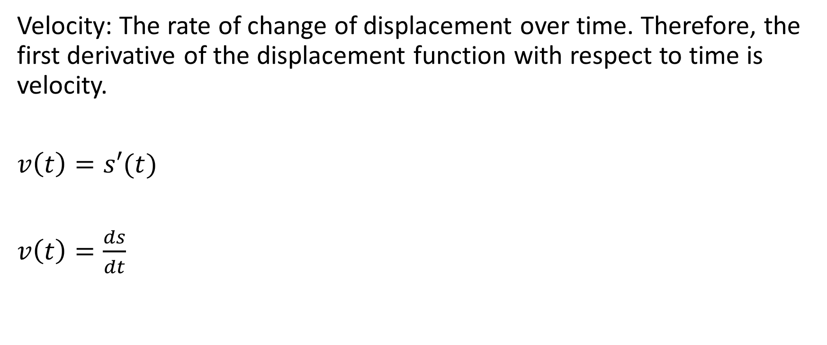
Velocity: The rate of change of displacement over time. Therefore, the first derivative of the displacement function with respect to time is velocity.
$v\left(t\right)=s′(t)$
$v\left(t\right)=\frac{ds}{dt}$

Slide 5
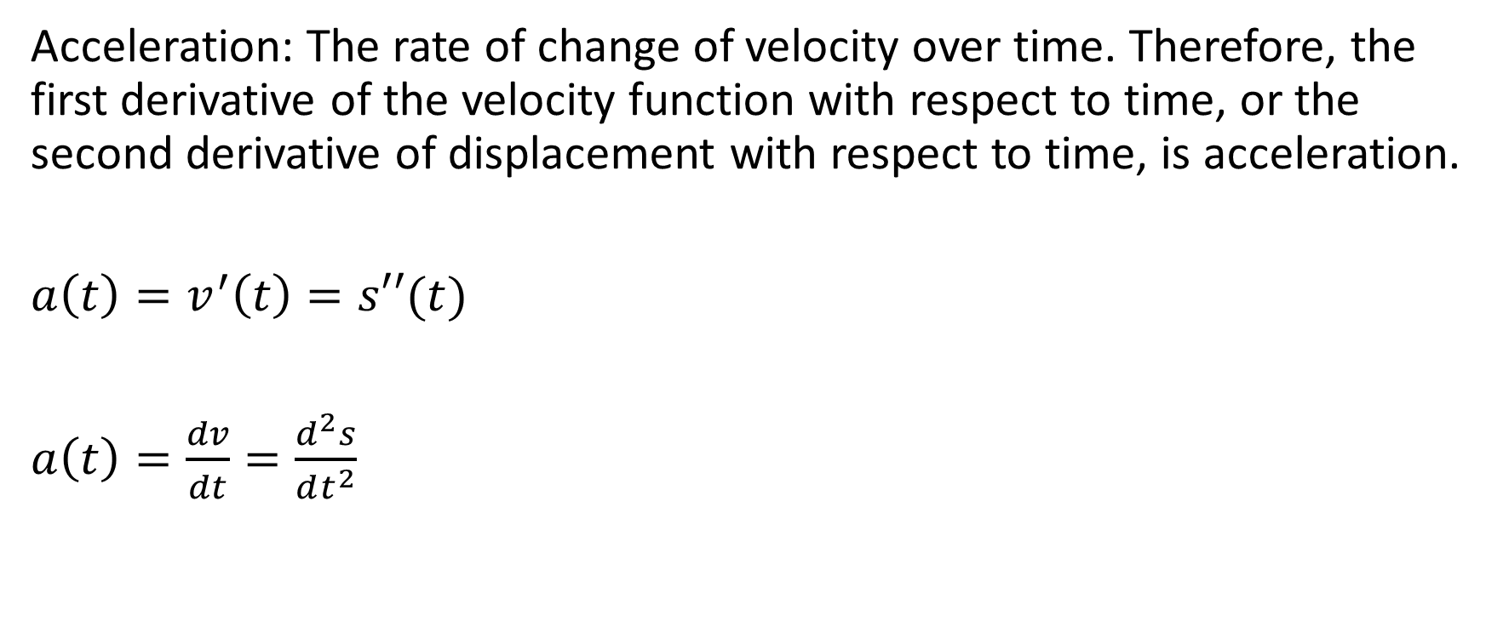
Acceleration: The rate of change of velocity over time. Therefore, the first derivative of the velocity function with respect to time, or the second derivative of displacement with respect to time, is acceleration.
$a\left(t\right)=v^{′}\left(t\right)=s′′(t)$
$a\left(t\right)=\frac{dv}{dt}=\frac{d^{2}s}{dt^{2}}$

Slide 6
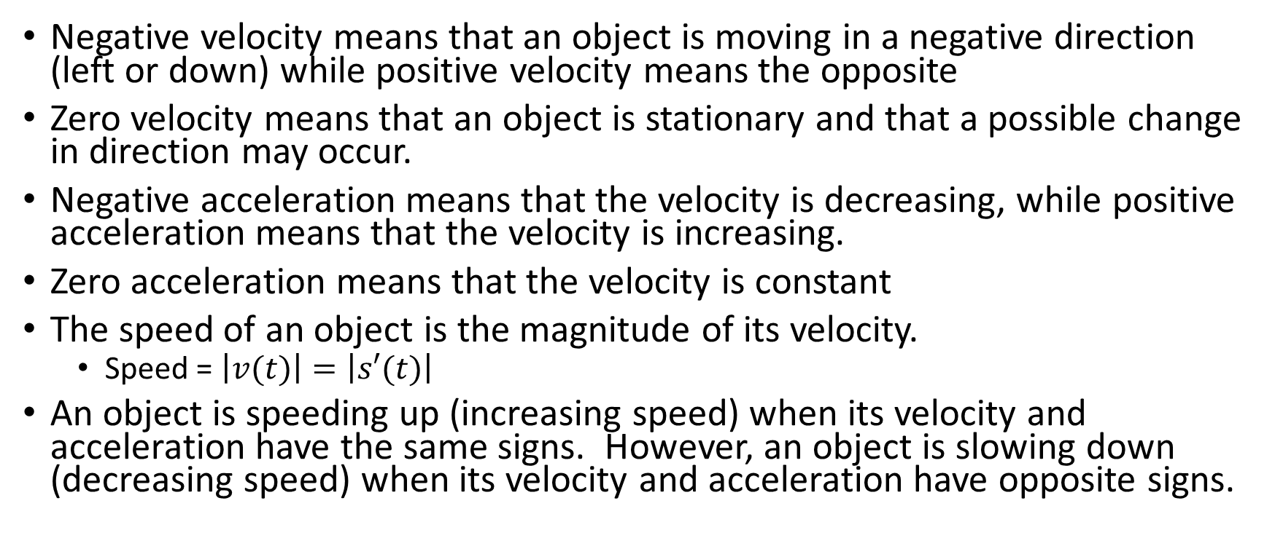
Negative velocity means that an object is moving in a negative direction (left or down) while positive velocity means the opposite
Zero velocity means that an object is stationary and that a possible change in direction may occur.
Negative acceleration means that the velocity is decreasing, while positive acceleration means that the velocity is increasing.
Zero acceleration means that the velocity is constant
The speed of an object is the magnitude of its velocity.
Speed = $\left|v(t)\right|=\left|s′(t)\right|$
An object is speeding up (increasing speed) when its velocity and acceleration have the same signs. However, an object is slowing down (decreasing speed) when its velocity and acceleration have opposite signs.

Slide 7

If the displacement is measured in metres and time is measured in seconds, then velocity is measured in $m/s$ and the acceleration is measured in $m/s^{2}$.

Slide 8

Example
Determine the second derivative, simplified, of $f\left(x\right)= \frac{x}{1+x}$
Then, determine the value of the second derivative when x = 1.

Slide 9
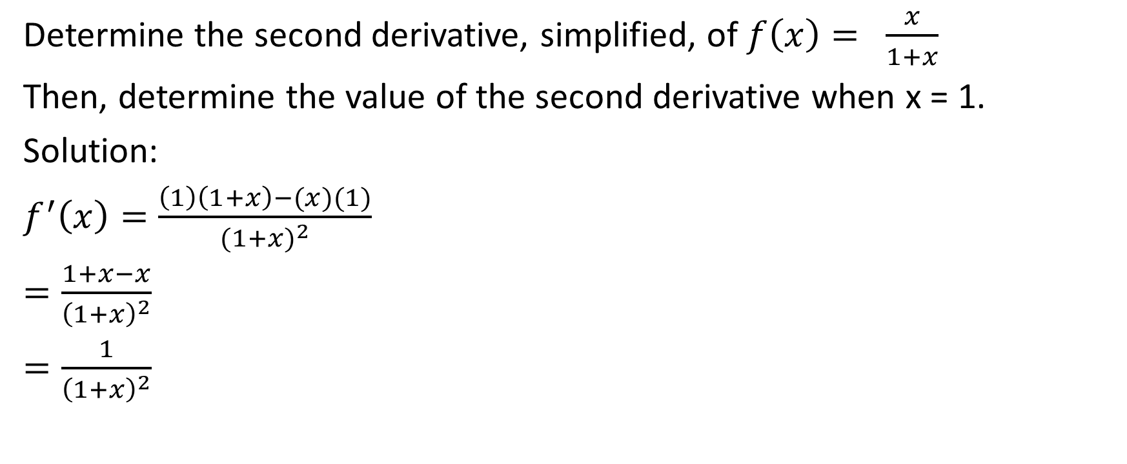
Determine the second derivative, simplified, of $f\left(x\right)= \frac{x}{1+x}$
Then, determine the value of the second derivative when x = 1.
Solution:
$f^{′}\left(x\right)=\frac{\left(1\right)\left(1+x\right)−(x)(1)}{{(1+x)}^{2}}$
$=\frac{1+x−x}{{\left(1+x\right)}^{2}}$
$=\frac{1}{{\left(1+x\right)}^{2}}$

Slide 10
Determine the second derivative, simplified, of $f\left(x\right)= \frac{x}{1+x}$
Then, determine the value of the second derivative when x = 1.
Solution:
$f^{′}\left(x\right)=\frac{\left(1\right)\left(1+x\right)−(x)(1)}{{(1+x)}^{2}}$
$=\frac{1+x−x}{{\left(1+x\right)}^{2}}$
$=\frac{1}{{\left(1+x\right)}^{2}}$
It is important to simplify the first derivative before determining the second derivative.

Slide 11
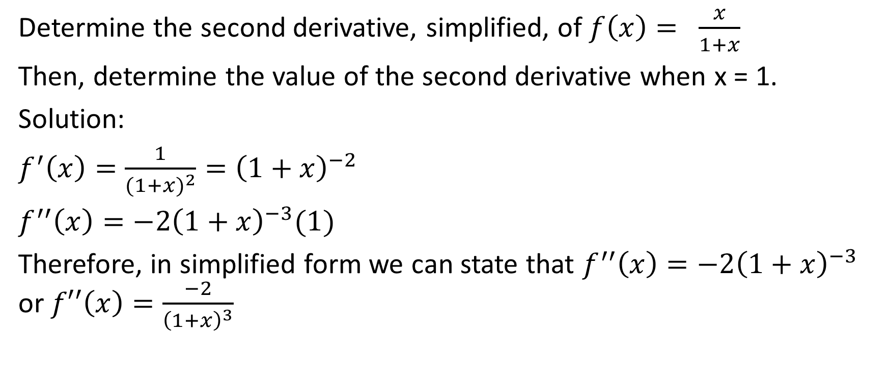
Determine the second derivative, simplified, of $f\left(x\right)= \frac{x}{1+x}$
Then, determine the value of the second derivative when x = 1.
Solution:
$f^{′}\left(x\right)=\frac{1}{{(1+x)}^{2}}={\left(1+x\right)}^{−2}$
$f^{′′}\left(x\right)=−2{\left(1+x\right)}^{−3}(1)$
Therefore, in simplified form we can state that $f^{′′}\left(x\right)=−2{\left(1+x\right)}^{−3}$ or $f′′\left(x\right)=\frac{−2}{{\left(1+x\right)}^{3}}$

Slide 12

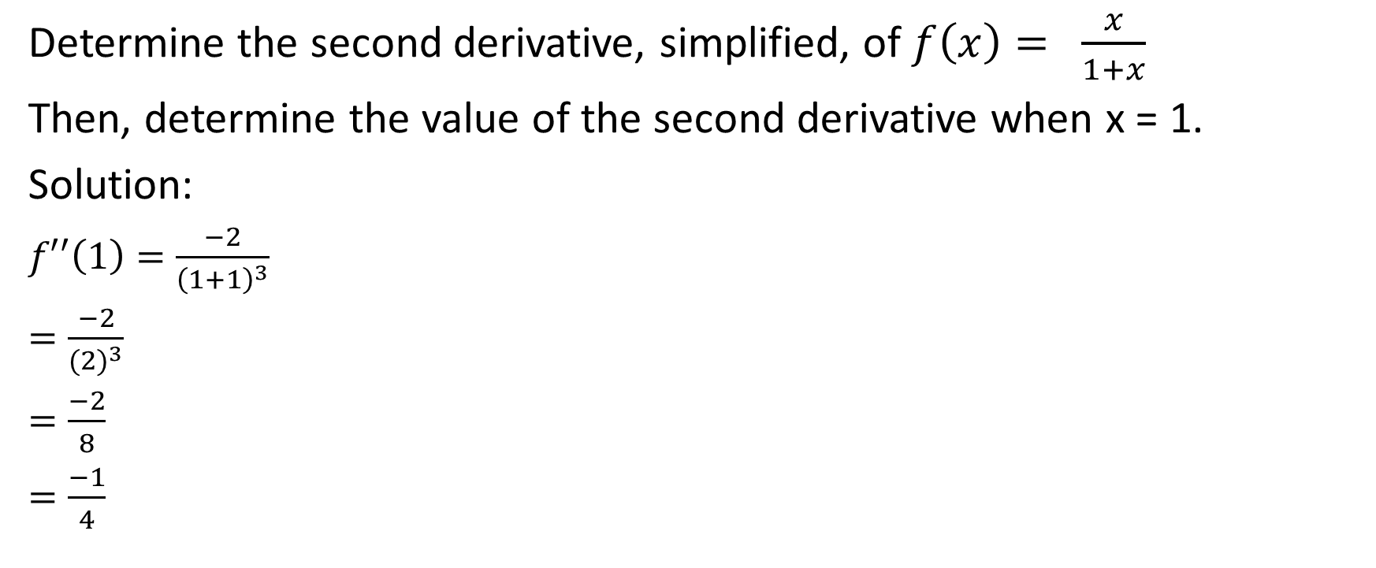
Determine the second derivative, simplified, of $f\left(x\right)= \frac{x}{1+x}$
Then, determine the value of the second derivative when x = 1.
Solution:
$f′′\left(1\right)=\frac{−2}{{\left(1+1\right)}^{3}}$
$=\frac{−2}{{(2)}^{3}}$
$=\frac{−2}{8}$
$=\frac{−1}{4}$
Therefore, the value of the second derivative at x = 1 is $\frac{−1}{4}$

Slide 13

Example
A baseball is hit vertically upward. The position function, $s\left(t\right),$in metres, of the ball above the ground is $s\left(t\right)=−5t^{2}+30t+1$, where $t$ is in seconds.
Determine the maximum height reached by the ball.
Determine the velocity of the ball when it is caught 1 m above the ground.

Slide 14
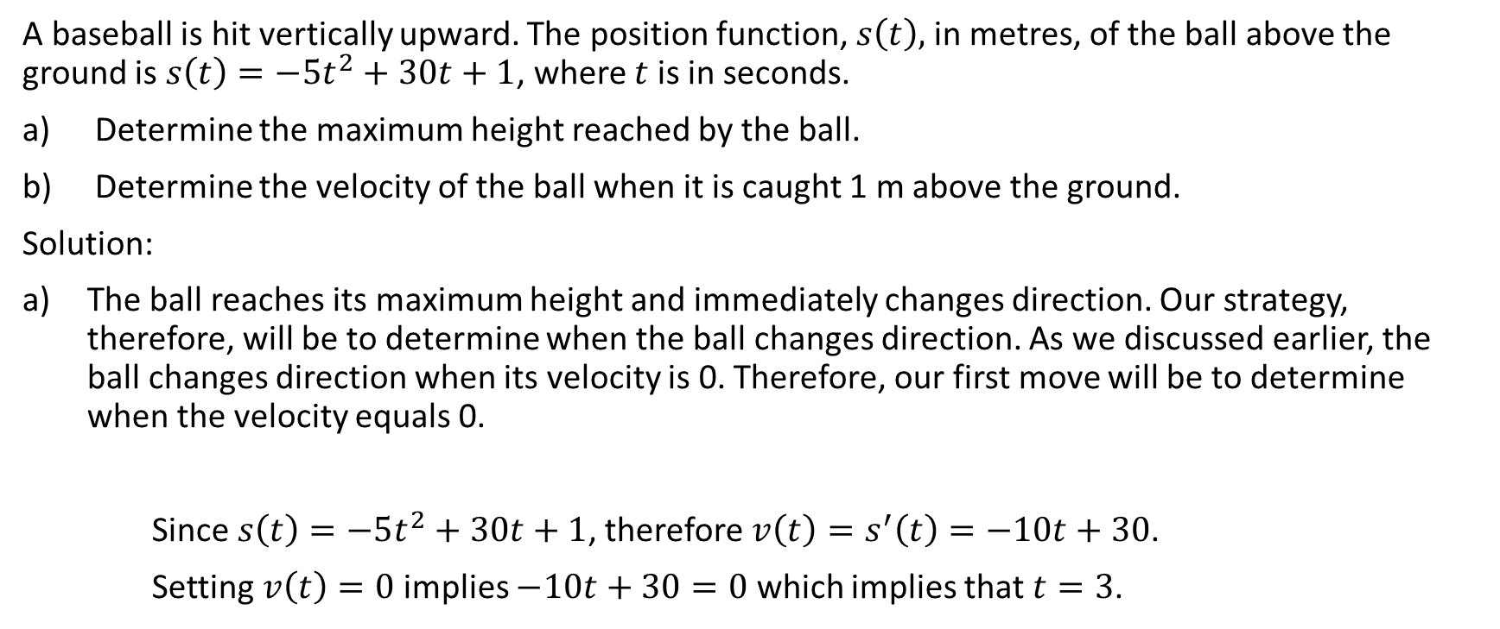
Example
A baseball is hit vertically upward. The position function, $s\left(t\right),$in metres, of the ball above the ground is $s\left(t\right)=−5t^{2}+30t+1$, where $t$ is in seconds.
Determine the maximum height reached by the ball.
Determine the velocity of the ball when it is caught 1 m above the ground.
Solution:
The ball reaches its maximum height and immediately changes direction. Our strategy, therefore, will be to determine when the ball changes direction. As we discussed earlier, the ball changes direction when its velocity is 0. Therefore, our first move will be to determine when the velocity equals 0.
Since $s\left(t\right)=−5t^{2}+30t+1$, therefore $v\left(t\right)=s^{′}\left(t\right)=−10t+30$.
Setting $v\left(t\right)=0$ implies $−10t+30=0$ which implies that $t=3$.

Slide 15
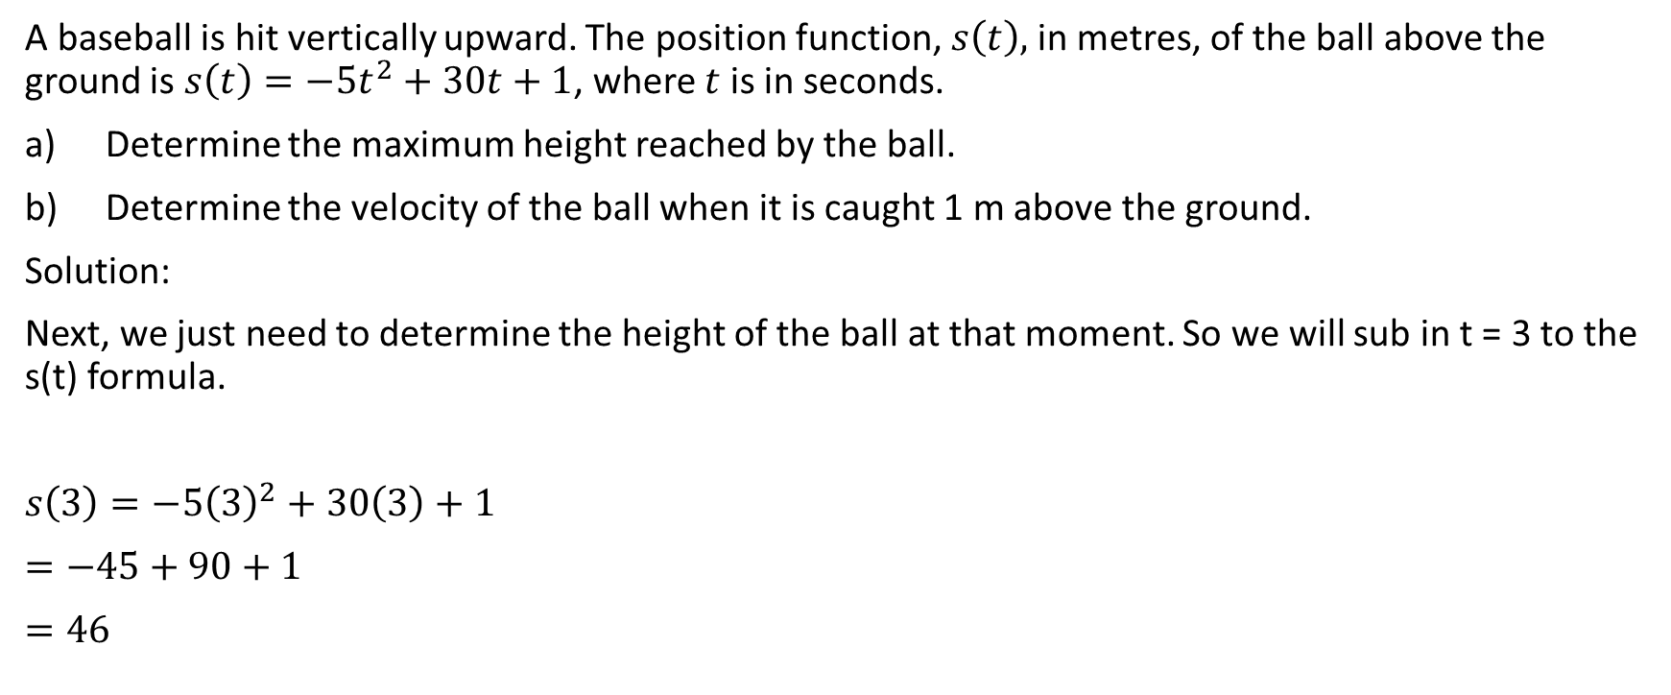
A baseball is hit vertically upward. The position function, $s\left(t\right),$in metres, of the ball above the ground is $s\left(t\right)=−5t^{2}+30t+1$, where $t$ is in seconds.
Determine the maximum height reached by the ball.
Determine the velocity of the ball when it is caught 1 m above the ground.
Solution:
Next, we just need to determine the height of the ball at that moment. So we will sub in t = 3 to the s(t) formula.
$s\left(3\right)=−5{\left(3\right)}^{2}+30\left(3\right)+1$
$=−45+90+1$
$=46$
Therefore the maximum height reached by the ball is 46 m.

Slide 16
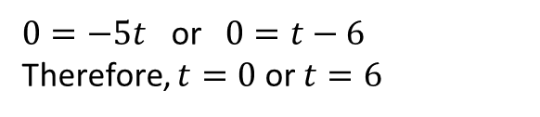
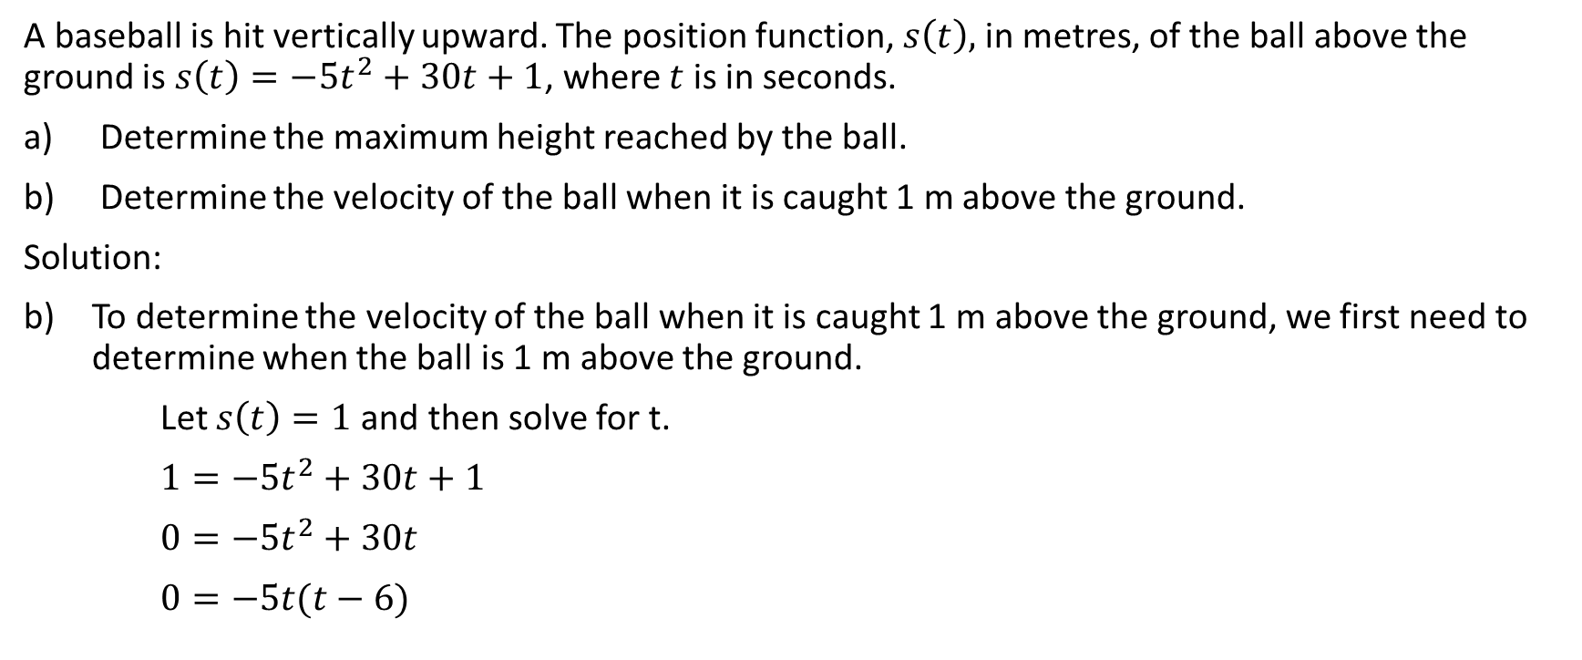

Example
A baseball is hit vertically upward. The position function, $s\left(t\right),$in metres, of the ball above the ground is $s\left(t\right)=−5t^{2}+30t+1$, where $t$ is in seconds.
Determine the maximum height reached by the ball.
Determine the velocity of the ball when it is caught 1 m above the ground.
Solution:
To determine the velocity of the ball when it is caught 1 m above the ground, we first need to determine when the ball is 1 m above the ground.
Let $s\left(t\right)=1$and then solve for t.
$1=−{5t}^{2}+30t+1$
$0=−5t^{2}+30t$
$0=−5t(t−6)$
$0=−5t$ or $0=t−6$
Therefore, $t=0$ or $t=6$

Slide 17

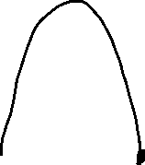
A baseball is hit vertically upward. The position function, $s\left(t\right),$in metres, of the ball above the ground is $s\left(t\right)=−5t^{2}+30t+1$, where $t$ is in seconds.
Determine the maximum height reached by the ball.
Determine the velocity of the ball when it is caught 1 m above the ground.
Solution:
The time of t = 0 represents the moment that the baseball is hit. The time of t = 6 represents the moment when the baseball is caught.

Slide 18
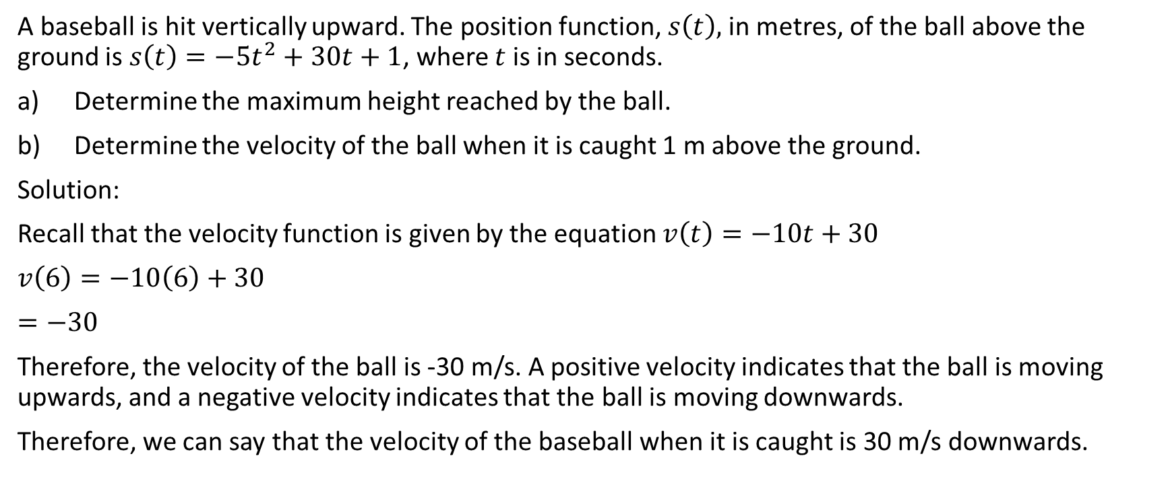
A baseball is hit vertically upward. The position function, $s\left(t\right),$in metres, of the ball above the ground is $s\left(t\right)=−5t^{2}+30t+1$, where $t$ is in seconds.
Determine the maximum height reached by the ball.
Determine the velocity of the ball when it is caught 1 m above the ground.
Solution:
Recall that the velocity function is given by the equation $v\left(t\right)=−10t+30$
$v\left(6\right)=−10\left(6\right)+30$
$=−30$
Therefore, the velocity of the ball is -30 m/s. A positive velocity indicates that the ball is moving upwards, and a negative velocity indicates that the ball is moving downwards.
Therefore, we can say that the velocity of the baseball when it is caught is 30 m/s downwards.

Slide 19
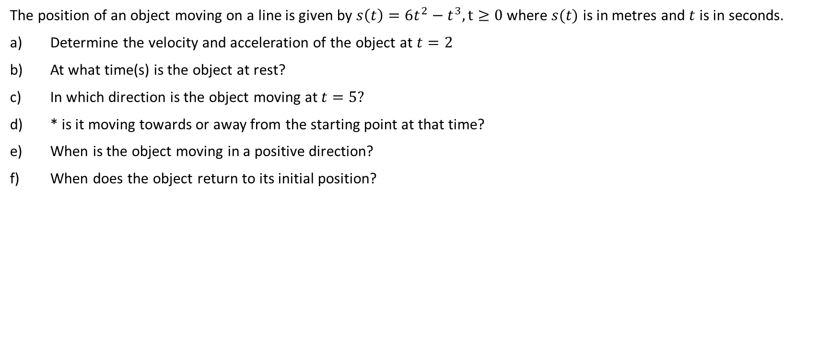
Example
The position of an object moving on a line is given by $s\left(t\right)=6t^{2}−t^{3}, t≥0$ where $s(t)$ is in metres and $t$ is in seconds.
Determine the velocity and acceleration of the object at $t=2$
At what time(s) is the object at rest?
In which direction is the object moving at $t=5?$
* is it moving towards or away from the starting point at that time?
When is the object moving in a positive direction?
When does the object return to its initial position?

Slide 20

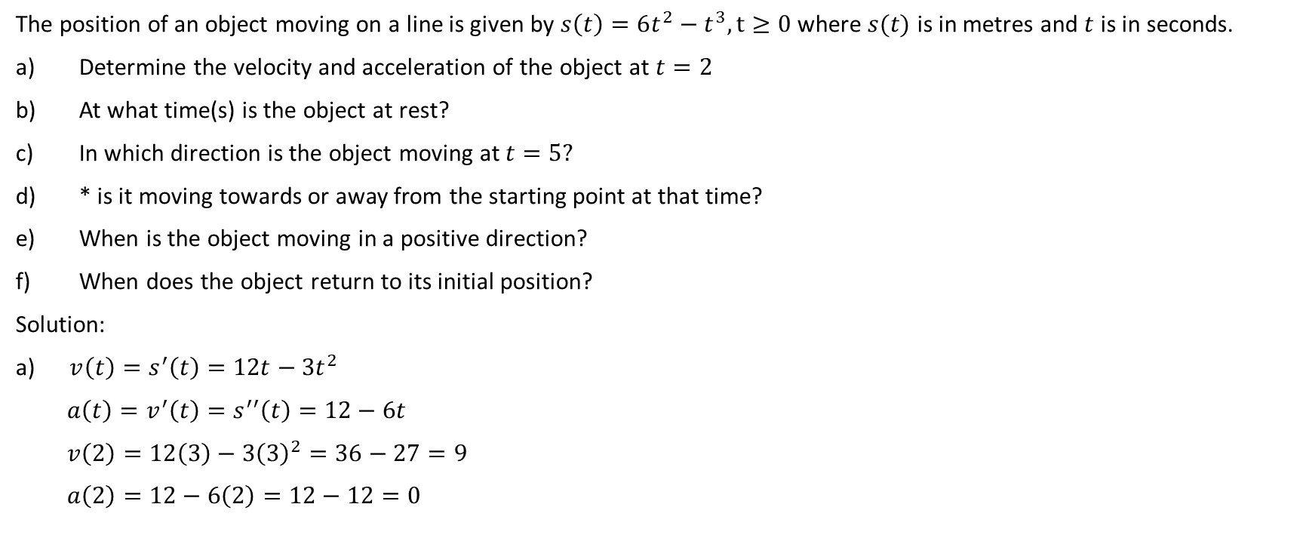
The position of an object moving on a line is given by $s\left(t\right)=6t^{2}−t^{3}, t≥0$ where $s(t)$ is in metres and $t$ is in seconds.
Determine the velocity and acceleration of the object at $t=2$
At what time(s) is the object at rest?
In which direction is the object moving at $t=5?$
* is it moving towards or away from the starting point at that time?
When is the object moving in a positive direction?
When does the object return to its initial position?
Solution:
a) $v\left(t\right)=s^{′}\left(t\right)=12t−3t^{2}$
$a\left(t\right)=v^{′}\left(t\right)=s^{′′}\left(t\right)=12−6t$
$v\left(2\right)=12\left(3\right)−3{\left(3\right)}^{2}=36−27=9$
$a\left(2\right)=12−6\left(2\right)=12−12=0$
Therefore, at t = 2, the velocity is 9 m/s, and the acceleration is $0 m/s^{2}$

Slide 21
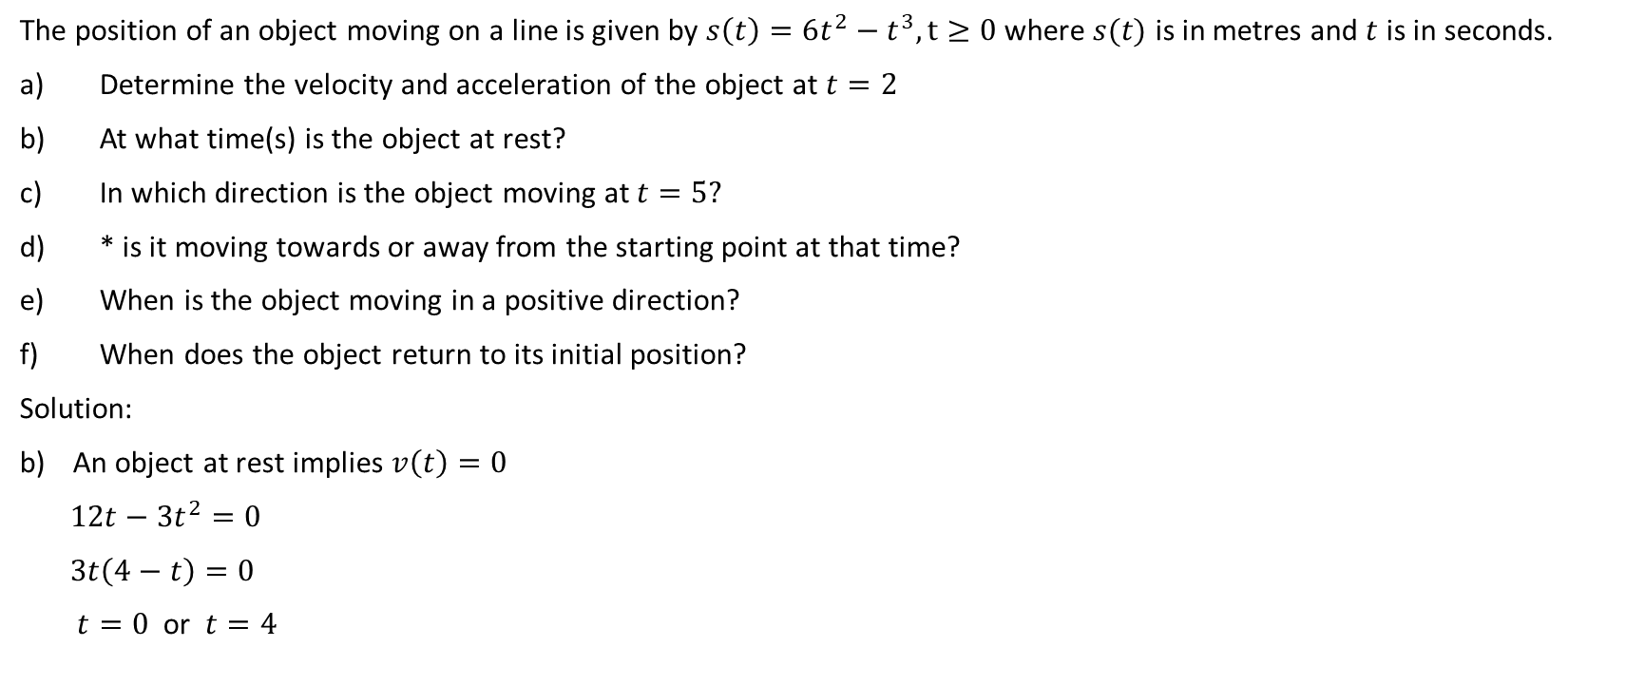
The position of an object moving on a line is given by $s\left(t\right)=6t^{2}−t^{3}, t≥0$ where $s(t)$ is in metres and $t$ is in seconds.
Determine the velocity and acceleration of the object at $t=2$
At what time(s) is the object at rest?
In which direction is the object moving at $t=5?$
* is it moving towards or away from the starting point at that time?
When is the object moving in a positive direction?
When does the object return to its initial position?
Solution:
An object at rest implies $v\left(t\right)=0$
$12t−3t^{2}=0$
$3t\left(4−t\right)=0$
$t=0$ or $t=4$
The object is at rest at a time of 0 seconds and at a time of 4 seconds.

Slide 22
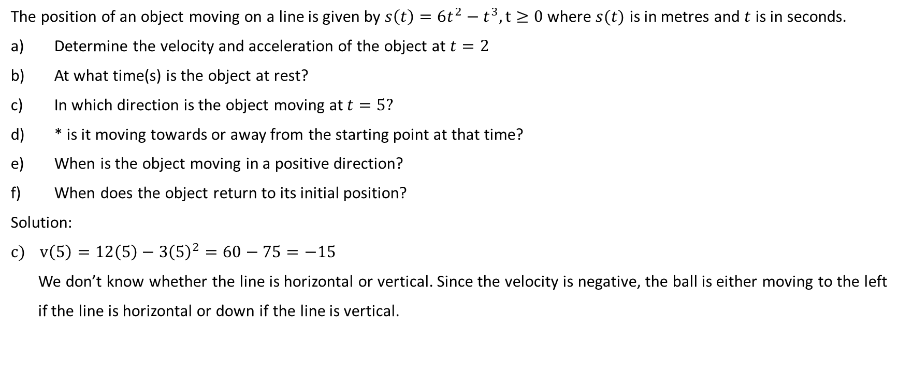
The position of an object moving on a line is given by $s\left(t\right)=6t^{2}−t^{3}, t≥0$ where $s(t)$ is in metres and $t$ is in seconds.
Determine the velocity and acceleration of the object at $t=2$
At what time(s) is the object at rest?
In which direction is the object moving at $t=5?$
* is it moving towards or away from the starting point at that time?
When is the object moving in a positive direction?
When does the object return to its initial position?
Solution:
$v\left(5\right)=12\left(5\right)−3{\left(5\right)}^{2}=60−75=−15$
We don’t know whether the line is horizontal or vertical. Since the velocity is negative, the ball is either moving to the left
if the line is horizontal or down if the line is vertical.

Slide 23
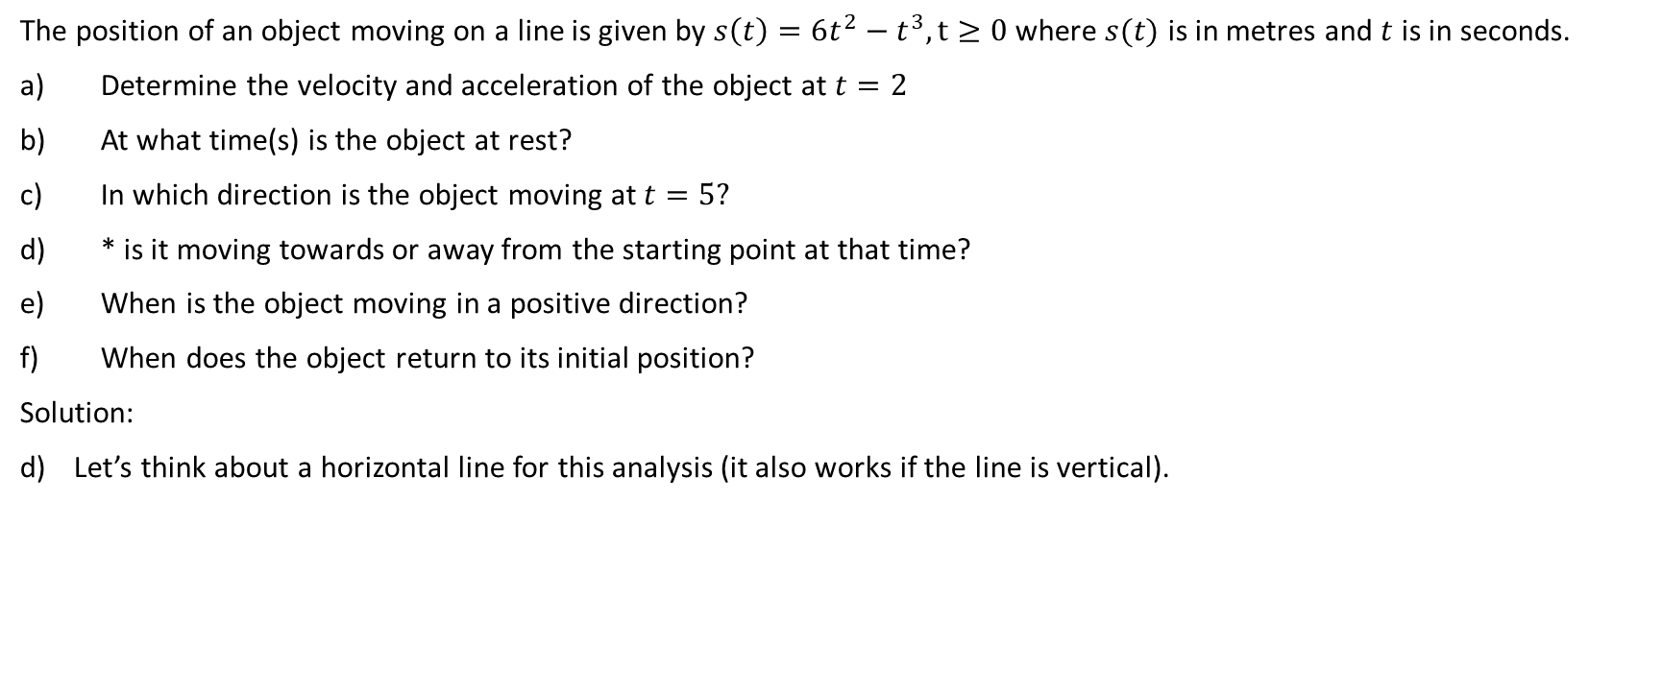
The position of an object moving on a line is given by $s\left(t\right)=6t^{2}−t^{3}, t≥0$ where $s(t)$ is in metres and $t$ is in seconds.
Determine the velocity and acceleration of the object at $t=2$
At what time(s) is the object at rest?
In which direction is the object moving at $t=5?$
* is it moving towards or away from the starting point at that time?
When is the object moving in a positive direction?
When does the object return to its initial position?
Solution:
Let’s think about a horizontal line for this analysis (it also works if the line is vertical).
First things first, let’s determine what the starting point is. The starting point is the displacement at t = 0.
$s\left(0\right)=6{(0)}^{2}−{\left(0\right)}^{3}=0−0=0.$ Therefore, the starting point is a displacement of 0.

Slide 24
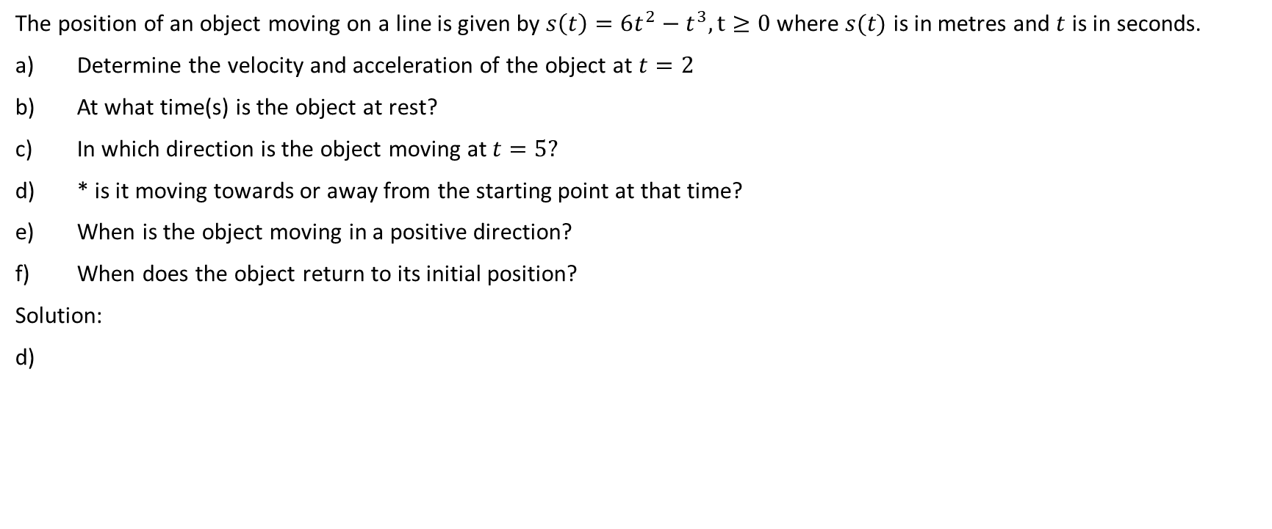
The position of an object moving on a line is given by $s\left(t\right)=6t^{2}−t^{3}, t≥0$ where $s(t)$ is in metres and $t$ is in seconds.
Determine the velocity and acceleration of the object at $t=2$
At what time(s) is the object at rest?
In which direction is the object moving at $t=5?$
* is it moving towards or away from the starting point at that time?
When is the object moving in a positive direction?
When does the object return to its initial position?
Solution:
0

Slide 25
The position of an object moving on a line is given by $s\left(t\right)=6t^{2}−t^{3}, t≥0$ where $s(t)$ is in metres and $t$ is in seconds.
Determine the velocity and acceleration of the object at $t=2$
At what time(s) is the object at rest?
In which direction is the object moving at $t=5?$
* is it moving towards or away from the starting point at that time?
When is the object moving in a positive direction?
When does the object return to its initial position?
Solution:
If the displacement s(t) is negative and the velocity v(t) is negative, then the object is to the left of the starting point and moving toward the left. The object would thus be moving away from the starting point.
0

Slide 26

The position of an object moving on a line is given by $s\left(t\right)=6t^{2}−t^{3}, t≥0$ where $s(t)$ is in metres and $t$ is in seconds.
Determine the velocity and acceleration of the object at $t=2$
At what time(s) is the object at rest?
In which direction is the object moving at $t=5?$
* is it moving towards or away from the starting point at that time?
When is the object moving in a positive direction?
When does the object return to its initial position?
Solution:
If the displacement s(t) is negative and the velocity v(t) is positive, then the object is to the left of the starting point and moving toward the right. The object would thus be moving towards the starting point.
0

Slide 27

The position of an object moving on a line is given by $s\left(t\right)=6t^{2}−t^{3}, t≥0$ where $s(t)$ is in metres and $t$ is in seconds.
Determine the velocity and acceleration of the object at $t=2$
At what time(s) is the object at rest?
In which direction is the object moving at $t=5?$
* is it moving towards or away from the starting point at that time?
When is the object moving in a positive direction?
When does the object return to its initial position?
Solution:
If the displacement s(t) is positive and the velocity v(t) is negative, then the object is to the right of the starting point and moving toward the left. The object would thus be moving towards the starting point.
0

Slide 28

The position of an object moving on a line is given by $s\left(t\right)=6t^{2}−t^{3}, t≥0$ where $s(t)$ is in metres and $t$ is in seconds.
Determine the velocity and acceleration of the object at $t=2$
At what time(s) is the object at rest?
In which direction is the object moving at $t=5?$
* is it moving towards or away from the starting point at that time?
When is the object moving in a positive direction?
When does the object return to its initial position?
Solution:
If the displacement s(t) is positive and the velocity v(t) is positive, then the object is to the right of the starting point and moving toward the right. The object would thus be moving away from the starting point.
0

Slide 29
The position of an object moving on a line is given by $s\left(t\right)=6t^{2}−t^{3}, t≥0$ where $s(t)$ is in metres and $t$ is in seconds.
Determine the velocity and acceleration of the object at $t=2$
At what time(s) is the object at rest?
In which direction is the object moving at $t=5?$
* is it moving towards or away from the starting point at that time?
When is the object moving in a positive direction?
When does the object return to its initial position?
Solution:
If the displacement s(t) is zero and the velocity v(t) is non-zero, then the object is moving away from the starting point.
0

Slide 30
The position of an object moving on a line is given by $s\left(t\right)=6t^{2}−t^{3}, t≥0$ where $s(t)$ is in metres and $t$ is in seconds.
Determine the velocity and acceleration of the object at $t=2$
At what time(s) is the object at rest?
In which direction is the object moving at $t=5?$
* is it moving towards or away from the starting point at that time?
When is the object moving in a positive direction?
When does the object return to its initial position?
Solution:
If the displacement s(t) is zero and the velocity v(t) is zero, then the object is neither moving away from nor towards the starting point.
0

Slide 31
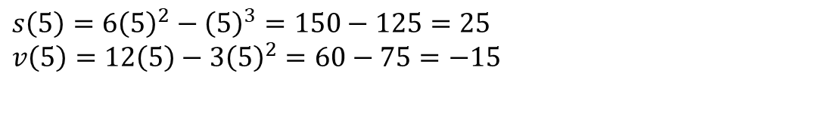
The position of an object moving on a line is given by $s\left(t\right)=6t^{2}−t^{3}, t≥0$ where $s(t)$ is in metres and $t$ is in seconds.
Determine the velocity and acceleration of the object at $t=2$
At what time(s) is the object at rest?
In which direction is the object moving at $t=5?$
* is it moving towards or away from the starting point at that time?
When is the object moving in a positive direction?
When does the object return to its initial position?
Solution:
$s\left(5\right)=6{\left(5\right)}^{2}−{\left(5\right)}^{3}=150−125=25$
$v\left(5\right)=12\left(5\right)−3{\left(5\right)}^{2}=60−75=−15$
0

Slide 32

The position of an object moving on a line is given by $s\left(t\right)=6t^{2}−t^{3}, t≥0$ where $s(t)$ is in metres and $t$ is in seconds.
Determine the velocity and acceleration of the object at $t=2$
At what time(s) is the object at rest?
In which direction is the object moving at $t=5?$
* is it moving towards or away from the starting point at that time?
When is the object moving in a positive direction?
When does the object return to its initial position?
Solution:
Therefore the displacement is positive and the velocity is negative. The object is moving towards the starting point at this time.
0

Slide 33
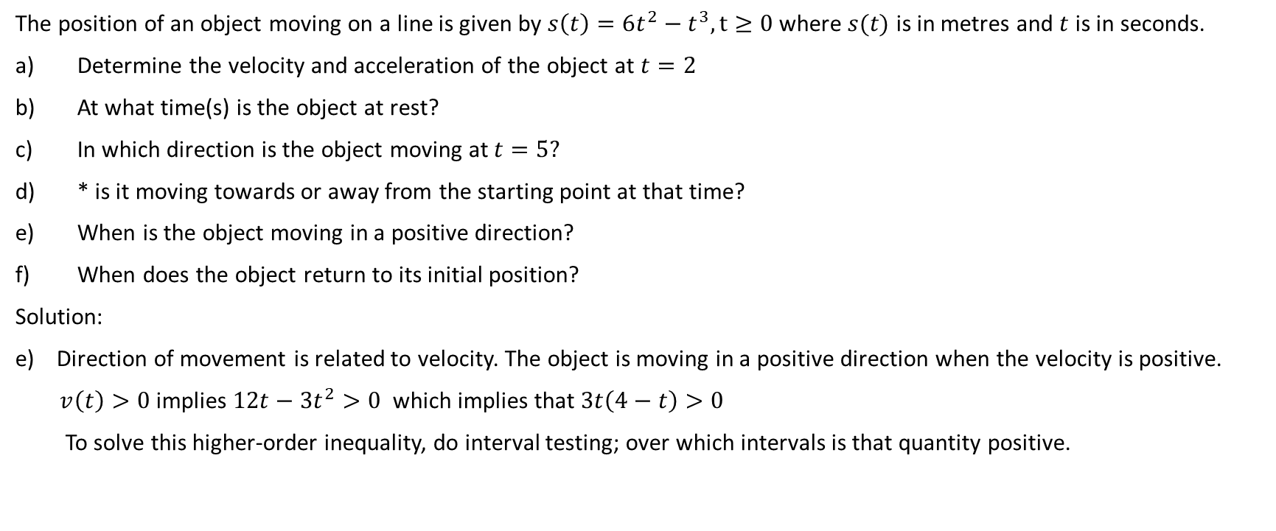
The position of an object moving on a line is given by $s\left(t\right)=6t^{2}−t^{3}, t≥0$ where $s(t)$ is in metres and $t$ is in seconds.
Determine the velocity and acceleration of the object at $t=2$
At what time(s) is the object at rest?
In which direction is the object moving at $t=5?$
* is it moving towards or away from the starting point at that time?
When is the object moving in a positive direction?
When does the object return to its initial position?
Solution:
Direction of movement is related to velocity. The object is moving in a positive direction when the velocity is positive.
$v\left(t\right)>0$ implies $12t−3t^{2}>0$ which implies that $3t\left(4−t\right)>0$
To solve this higher-order inequality, do interval testing; over which intervals is that quantity positive.

Slide 34
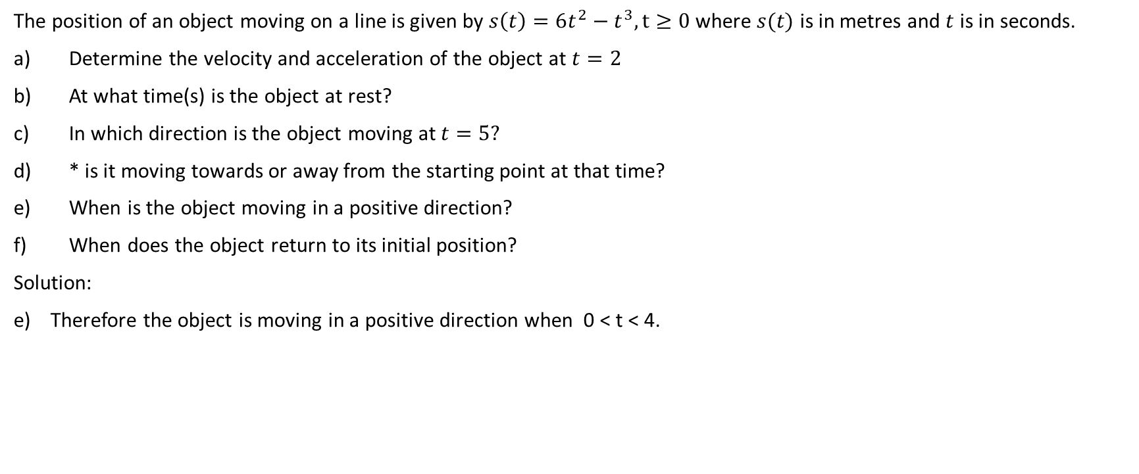
The position of an object moving on a line is given by $s\left(t\right)=6t^{2}−t^{3}, t≥0$ where $s(t)$ is in metres and $t$ is in seconds.
Determine the velocity and acceleration of the object at $t=2$
At what time(s) is the object at rest?
In which direction is the object moving at $t=5?$
* is it moving towards or away from the starting point at that time?
When is the object moving in a positive direction?
When does the object return to its initial position?
Solution:
Therefore the object is moving in a positive direction when 0 < t < 4.

Slide 35
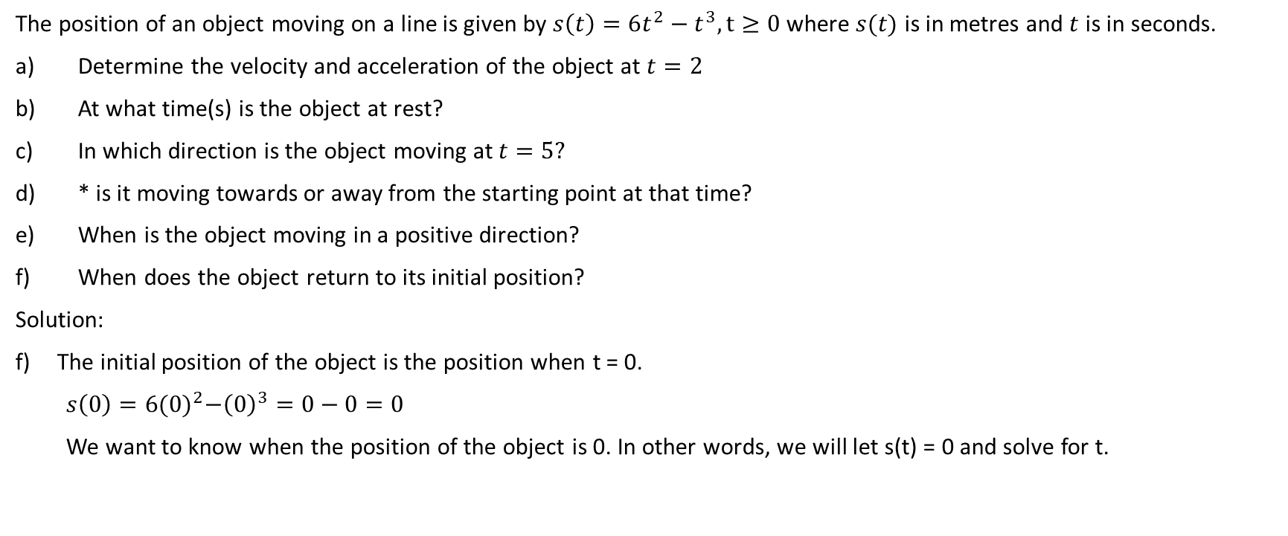
The position of an object moving on a line is given by $s\left(t\right)=6t^{2}−t^{3}, t≥0$ where $s(t)$ is in metres and $t$ is in seconds.
Determine the velocity and acceleration of the object at $t=2$
At what time(s) is the object at rest?
In which direction is the object moving at $t=5?$
* is it moving towards or away from the starting point at that time?
When is the object moving in a positive direction?
When does the object return to its initial position?
Solution:
The initial position of the object is the position when t = 0.
$s\left(0\right)=6{(0)}^{2}−{\left(0\right)}^{3}=0−0=0$
We want to know when the position of the object is 0. In other words, we will let s(t) = 0 and solve for t.

Slide 36
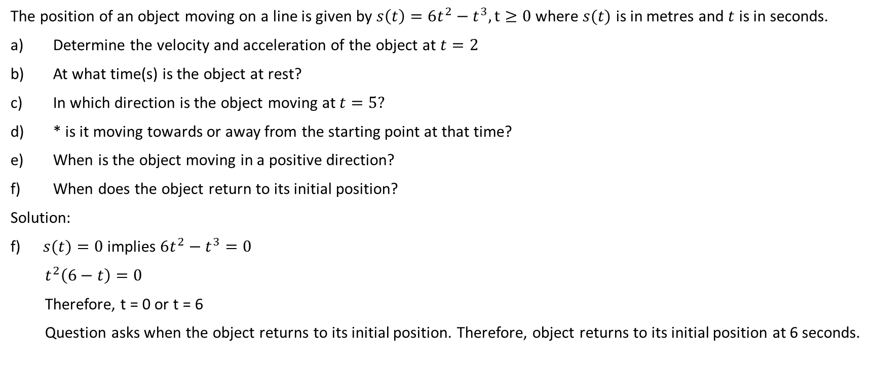
The position of an object moving on a line is given by $s\left(t\right)=6t^{2}−t^{3}, t≥0$ where $s(t)$ is in metres and $t$ is in seconds.
Determine the velocity and acceleration of the object at $t=2$
At what time(s) is the object at rest?
In which direction is the object moving at $t=5?$
* is it moving towards or away from the starting point at that time?
When is the object moving in a positive direction?
When does the object return to its initial position?
Solution:
$s(t)=0$ implies $6t^{2}−t^{3}=0$
$t^{2}\left(6−t\right)=0$
Therefore, t = 0 or t = 6
Question asks when the object returns to its initial position. Therefore, object returns to its initial position at 6 seconds.

